Slide 1
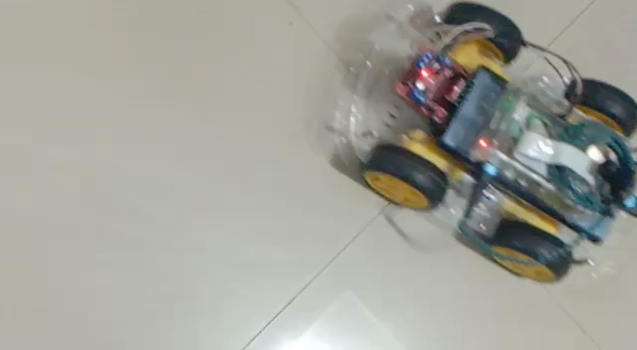
RESULTS AND DISCUSSION

Slide 2
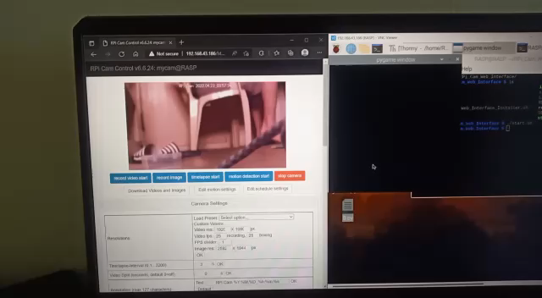
RESULTS AND DISCUSSION

Slide 3
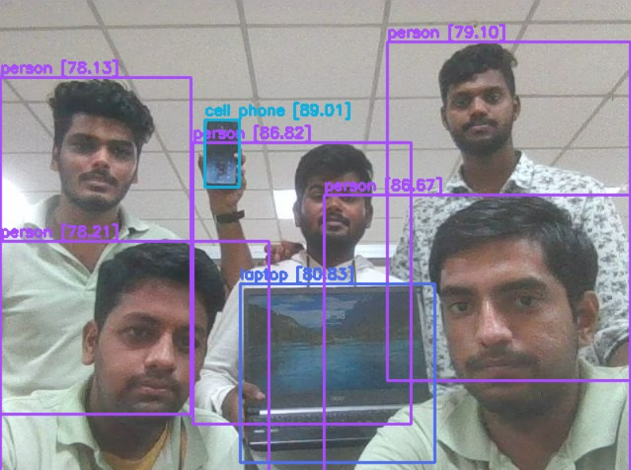
RESULTS AND DISCUSSION
Figure 14: Final object detection system using YOLO V3.

Slide 4
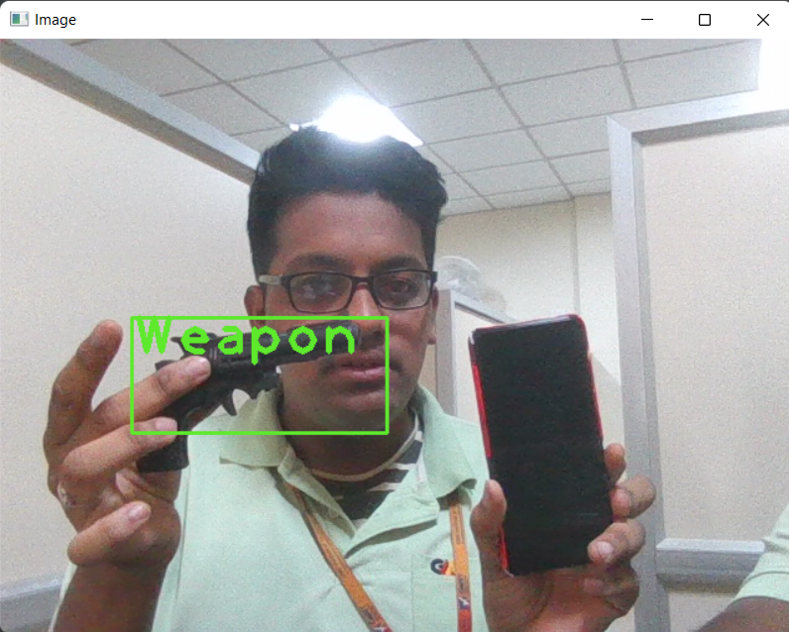
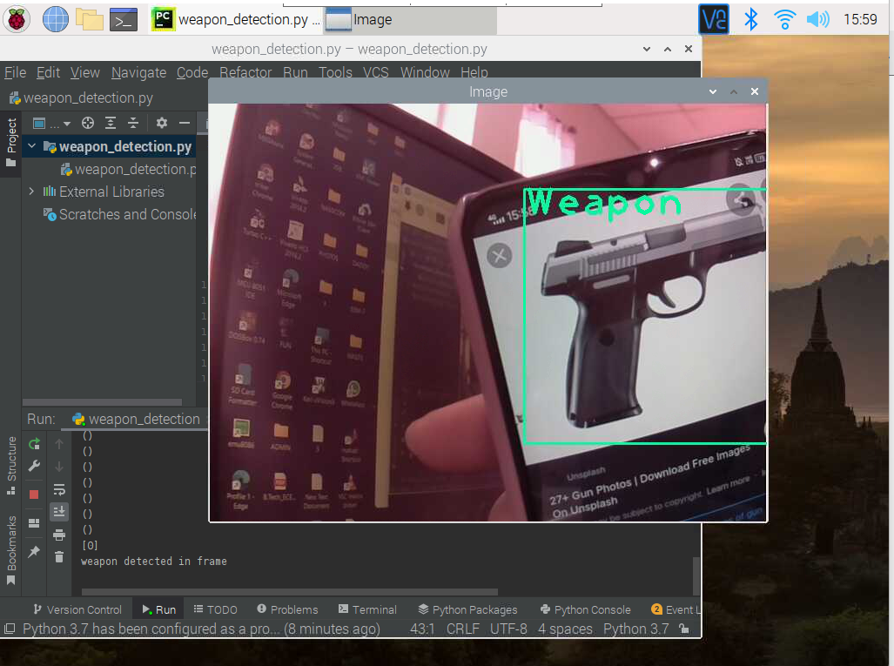
RESULTS AND DISCUSSION
Figure 15: Physical gun detected in the frame and being alerted.
Figure 16: Gun detected in the frame as weapon and being alerted.

